Slide 1
Project Presentation for CS598 DL4H in Spring 2023
Ambarish Tripathi and Debabrata Biswas {at37, dbiswas3}@illinois.edu
Group Id: 10 Paper Id: 85

Slide 2
Agenda
Introduction / Problem Description
HiCu Algorithm
HiCu Architecture / Approach taken in the paper
HiCu Results (from Original Paper)
Implementation / Reproduction Attempts
Ablation / Code Modification – 1
Ablation / Code Modification – 2 and 3
Results (before making code changes)
Results (after making code changes)
Discussion
Conclusion

Slide 3
Introduction / Problem Description
Paper: "HiCu: Leveraging Hierarchy for Curriculum Learning in Automated ICD Coding" by Ren et al.
The HiCu paper addresses the problem of automated coding of medical diagnoses and procedures using the International Classification of Diseases (ICD) system.
Mapping clinical notes, discharge summaries, and patient profiles to ICD codes is a time-consuming and error-prone task.
The complex relationships between the many possible codes make automated ICD coding a challenging task.
The paper proposes a novel hierarchical curriculum learning approach to improve the accuracy and efficiency of automated ICD coding.
By leveraging the hierarchical structure of the ICD codes, the HiCu approach is designed to improve the model's ability to learn complex relationships between codes.
The importance of this problem cannot be overstated as it can help reduce costs for patients and providers, streamline medical workflows, and improve healthcare outcomes.

Slide 4
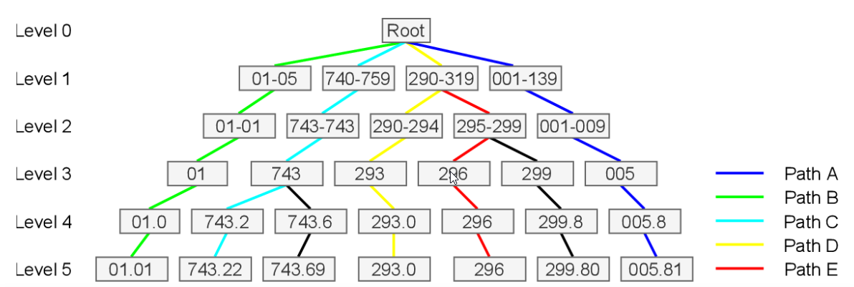
HiCu Algorithm - ICD code label tree
HiCu Algorithm is a hierarchical curriculum learning approach that leverages the hierarchical structure of the ICD codes to improve the accuracy and efficiency of automated ICD coding. An example ICD code is shown here.

Slide 5
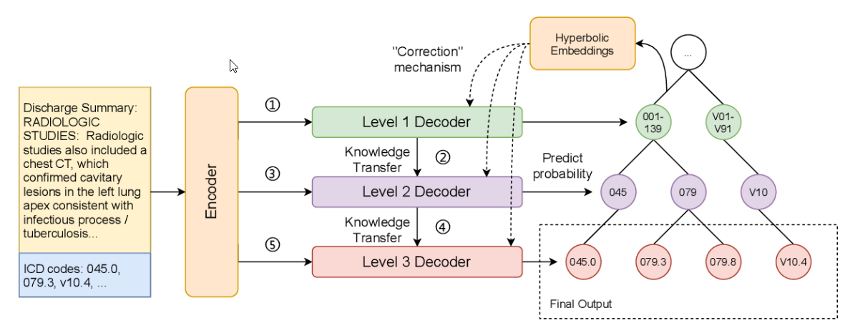
HiCu Architecture
Key Components:
Encoder-Decoder Framework: The HiCu architecture consists of an encoder-decoder framework that is combined with a hierarchical curriculum learning algorithm.
Sequential Training Algorithm: The model is trained in a sequential algorithmic framework, where simpler codes are learned before more complex codes. The model is first trained on labels at the first level of the label tree using a level one decoder and then proceeds to level two using a knowledge transfer mechanism.
Hyperbolic Embeddings: During training at each level, the hyperbolic embeddings of the ICD codes are used to guide the attention computation in the decoder. The hyperbolic embeddings allow the model to learn a representation of the ICD code hierarchy that is more structured and aligned with the hierarchical structure of the codes.
High-order Grouping of ICD Code Blocks: The HiCu algorithm uses a high-order grouping of ICD code blocks to create a two-level hierarchy. This modification of the HiCu algorithm is trained on the MIMIC-III dataset to verify its performance.

Slide 6
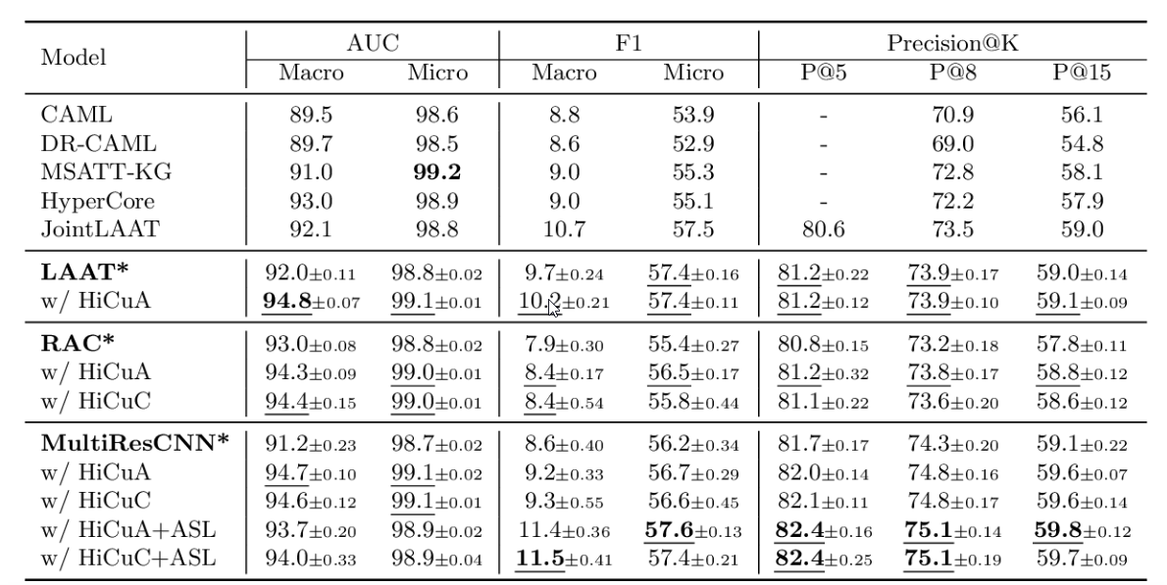
Results (from Original Paper)
MIMIC-III Full Code Results (in %). The results obtained are shown in means ± standard deviations from 10 random runs.
The first block in the table shows the baseline results reported in the papers.
The following three blocks specify three groups of experiments, each showing the baseline which was re-implemented in original paper (with *) and the corresponding models which were further evaluated with HiCu learning algorithm.
The bold values indicate the best results which was obtained from all experiments, whereas the underlined values indicate the best results among each experiment group, in the original paper.

Slide 7
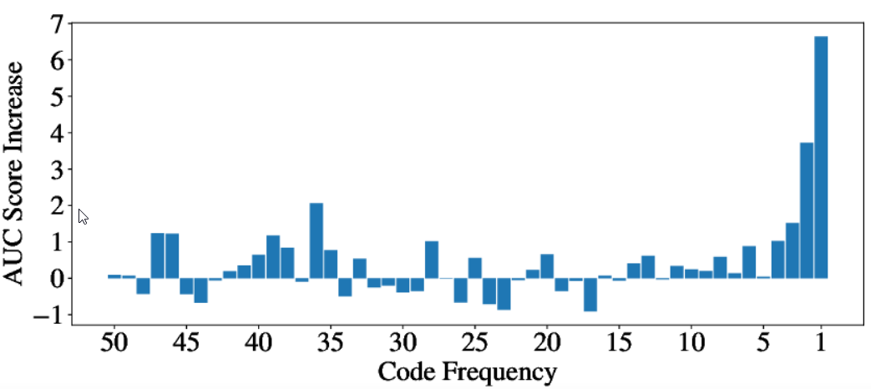
Results (from Original Paper) Contd..
AUC Improvements on Rare Codes:
AUC Score difference between vanilla MultiResCNN and (MultiResCNN w/ HiCuA+ASL).
ICD codes are grouped by their frequency (i.e. occurring times in ground truth).
This figure shows the increase of average AUC scores (in %) inside of each frequency group. For example, the size of the bar plot above code frequency ”1” indicates the increase of average AUC scores within the code subset that appears only once in the training set. The figure indicates a visible enhancement in rare code prediction.

Slide 8
Implementation / Reproduction Attempts
Reproduction attempts
The original design hypothesis for multilevel ICD-9 has been altered.
Modified a few hyper parameters from the original paper to compare changes.
Code changes / Implementation
The ICD-9 Code hierarchy has been flattened.
The result ICD codes follow 2 level depth - <root, code> (Ablation)
Reduce the Poincare/negative to 1.
Process of reproducing the results
Flattened the ICD-9 hierarchy to <root, code> (only 2 level)
The loss function and other metrics got worst, compared to the original paper.
Challenges encountered during the reproduction attempts
Hardware limitations e.g. GPU/CPU/RAM inadequate to run the entire dataset.

Slide 9

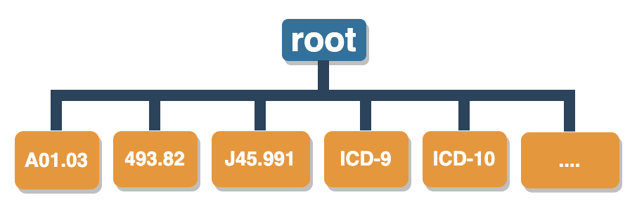
Ablation / Code Modification - 1
The following code has been modified to flatten the ICD-9 code:
source code - main.py

Slide 10
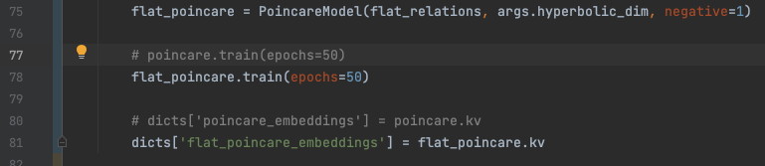
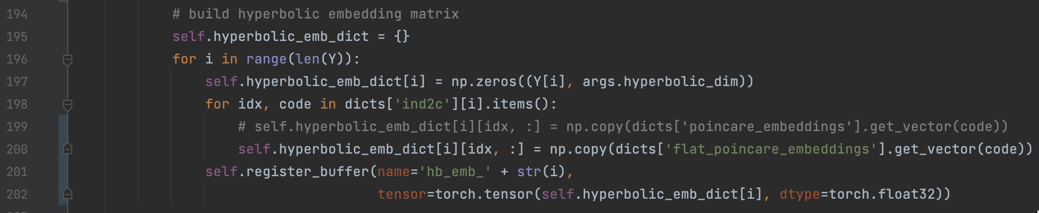
Ablation / Code Modification – 2 and 3
Sending the flattened hierarchy to Poincare model:
Using the flat Hierarchy to hyperbolic embedding matrix:

Slide 11
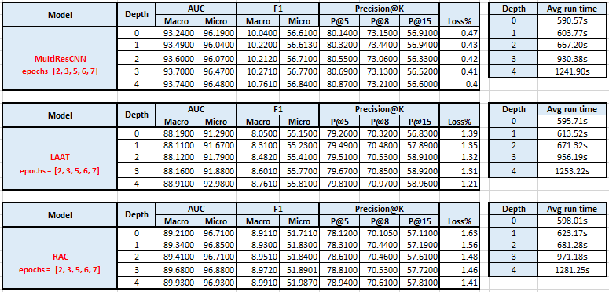
Results (before making code changes)

Slide 12
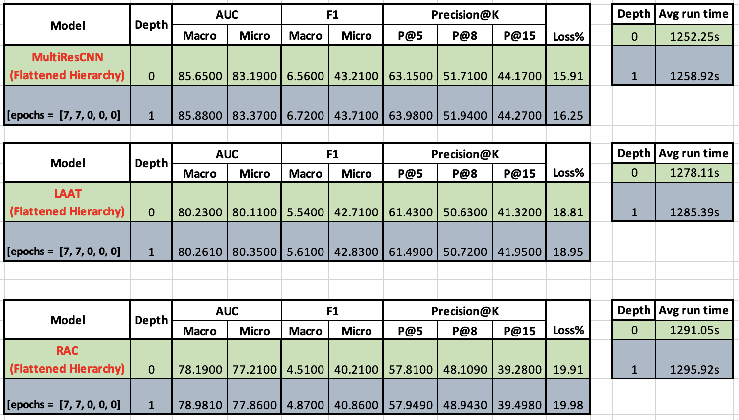
Results (after making code changes)

Slide 13
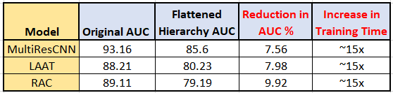
Discussion
Our project aimed to re-establish Hierarchical learning using the HiCu algorithm, which is more efficient than non-hierarchical learning of ICD-9 codes.
We compared HiCu performance using MultiResCNN, LAAT and RAC models with respect to different metrics and observed that HiCu performs better in tree structure training of ICD codes.
For Claim 1, we reduced the hierarchy by flattening the ICD code and observed that the model performed poorly than the original paper in most metrics, e.g. for AUC results. It proves the importance of the hierarchical structure in improving the multi-label classification performance of the HiCu algorithm. After flattening, performance degraded.
For Claim 2, we found that a reduced ICD Code Hierarchy model largely affected the training time since training time significantly increased as observed in the results.
The most exciting aspect of our research involved the ablation study in which we removed the ICD-9 Hierarchy and were still able to train the model.

Slide 14
Conclusion
We reaffirmed the objective of HiCu’s algorithm with an ablation study of flattening the hierarchy.
The HiCu algorithm is an innovative approach to automated ICD coding that takes advantage of the hierarchical structure of the ICD codes to improve the model's ability to learn complex relationships between the codes, which is difficult to achieve using traditional flat learning approaches.

Slide 15
THANK YOU

